Slide 1
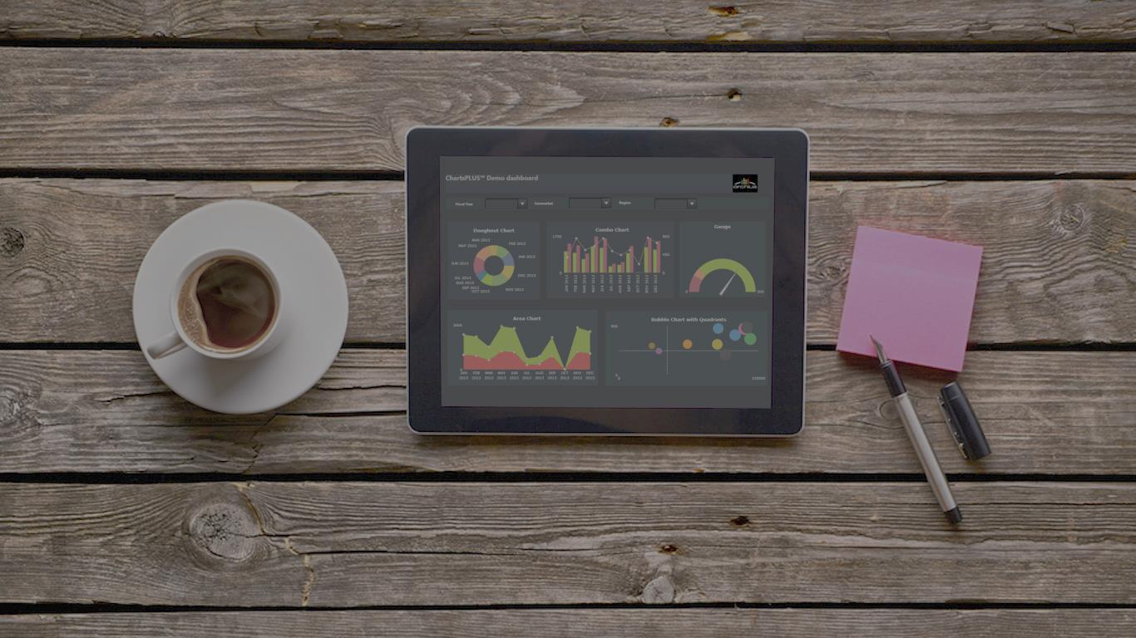

CORPBASE
Abhishek Choudhury | Amarjit Dhal | Ameya Ghatpande | Chaitrali Madhav Naik
Omkar Gokhale | Sahil Chandawale | Vaibhav Deorukhkar
GROUP 1

Slide 2
Agenda
Problem and our Inspiration
Storyboard - Demo
Our Approach
Working as a team
Learnings
Future Scope

Slide 3

Problem and our Inspiration
Problem
VC – Trend analysis
VC – Competitive analysis
Startup – Identify an ideal Market
HR – High attrition rate
Our Inspiration
HBO’s Silicon Valley
Startup Culture
Bridge between an idea and
an investor

Slide 4
VC’s Perspective
Keep a watch on my competitors
Their investment trends
Rapidly growing domains and companies
Live demo …

Slide 5
Startup Perspective
Track the money on the map
Funding pattern over the years
Growing domains in various states
Future expansion
Where the competition resides
Live demo …

Slide 6
HR Perspective
Analyze the trend of attrition rate
Seniority wise attrition analysis
Attrition rate comparison
Plan retention
Live demo …

Slide 7

OUR APPROACH
Notes:
Thank you Abhishek, Now all these dashboards and stories look good don’t they? But it is important to know what really goes behind ensuring that these dashboards give us the correct analysis.
As pointed out before, we are integrating data from Privco.com and Owler.com into the crunch base data, it was important to understand this source data well enough.

Slide 8

Data Profiling
Table & Column Analysis
Cross-table and Relationship Analysis
Understanding Data Completeness
Approximate time allocated – 20 %
Notes:
Now having received the data set, we first carried out Table and Column Analysis - find associations between the tables and its columns and decided the grain for our story.
Further, we did cross table analysis and established the relations between common domains and decided on how to relate the data that didn’t have any direct relations.

Slide 9
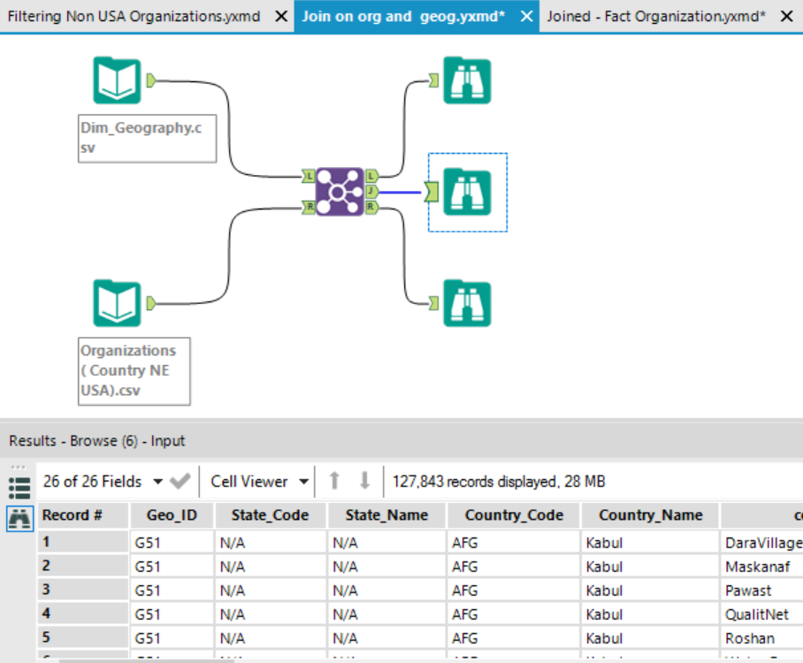
Data Cleaning/ Transformation
Handling Nulls
Date-Time consistency
Location format consistency
Cleaning junk problems
Filtering relevant data.
Using Joins from multiple sources
Approximate time allocated – 40 %
Notes:
Now, the reason why we spent a lot of time on this phase of our project is that although the data was comprehensive and met the requirements that we had set, the overall data quality was poor.
Lots of Null Values
Date and time in different formats since multiple sources of data were being integrated.
Lots of unnecessary data; data that in no way helped our analysis was present, so we had to filter out only the relevant columns.
Our location based story needed specific location ids in the main fact table to be joined from the location dimension, this was a tedious process because within the source data, say for example the companies that were US based companies had data that went to as down as the state level. Whereas, for rest of the regions, the data was only detailed to country level granularity.

Slide 10
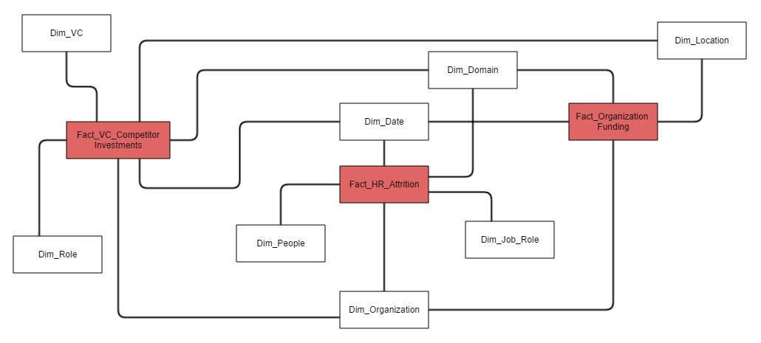
Data Modeling
Handling Nulls
Date-Time consistency
Location format consistency
Cleaning junk problems
Filtering relevant data.
Using Joins from multiple sources
Approximate time allocated – 40 %
Notes:
This is our conceptual model. Our dashboards primarily answer questions based on the organization, date, domain, & location dimensions. Hence these are our Conformed Dimensions.
The People dimension and Job Role dimension are used for specific facts; so they become our Role-Playing dimension.
The Organization_Funding and VC_Competitor are Additive Facts in our case and the HR_Attrition would be a Pseudo Fact as we just want to track the event when leaves his job.
Since there are multiple facts with conformed dimensions -> We prefer calling this – a Fact Constellation.
A detailed version of this model would be a part of the project report.

Slide 11

LEARNINGS FROM THE PROJECT

Slide 12




Mapping concepts from class
Enhancing tool knowledge

Slide 13
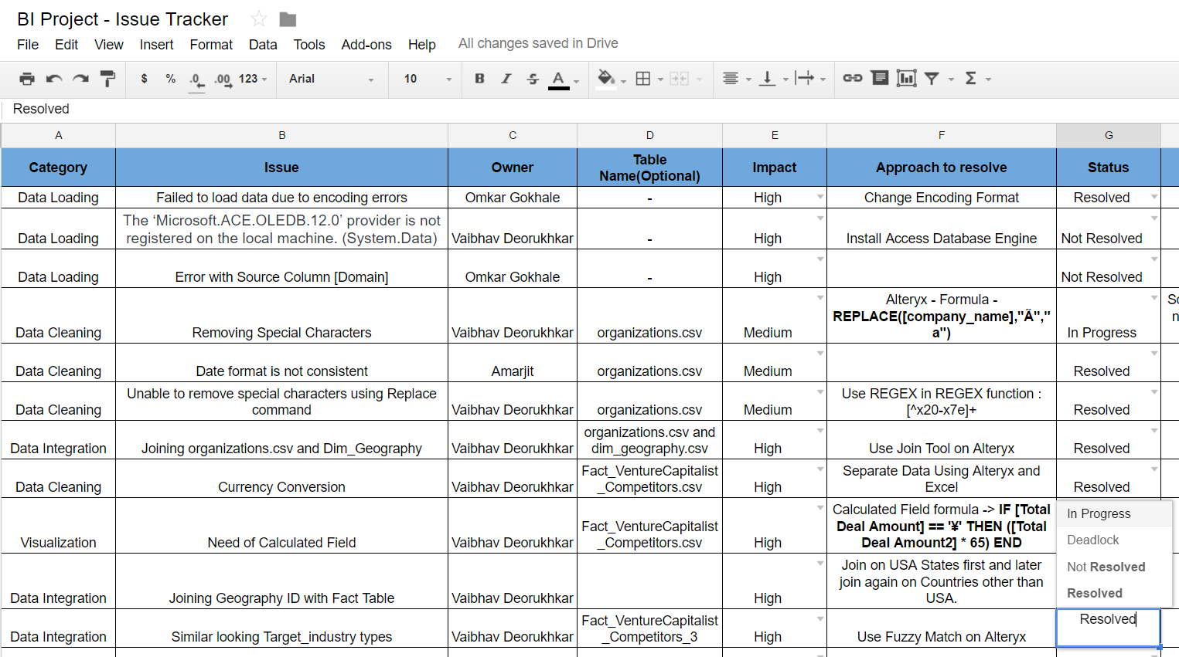
Project Management
Time Management

Slide 14

WORKING AS A TEAM

Slide 15
Startup culture (Flat hierarchy) - Contribute what you are good at
Knowledge sharing
Scrum methodology
Update status/problems in shared drive - Discussed during Standup meetings

Slide 16

FUTURE SCOPE

Slide 17
Predictive analytics
Analyze the events and funding trends
Integration with social media
Which companies my employees joining

Slide 18


